Slide 1
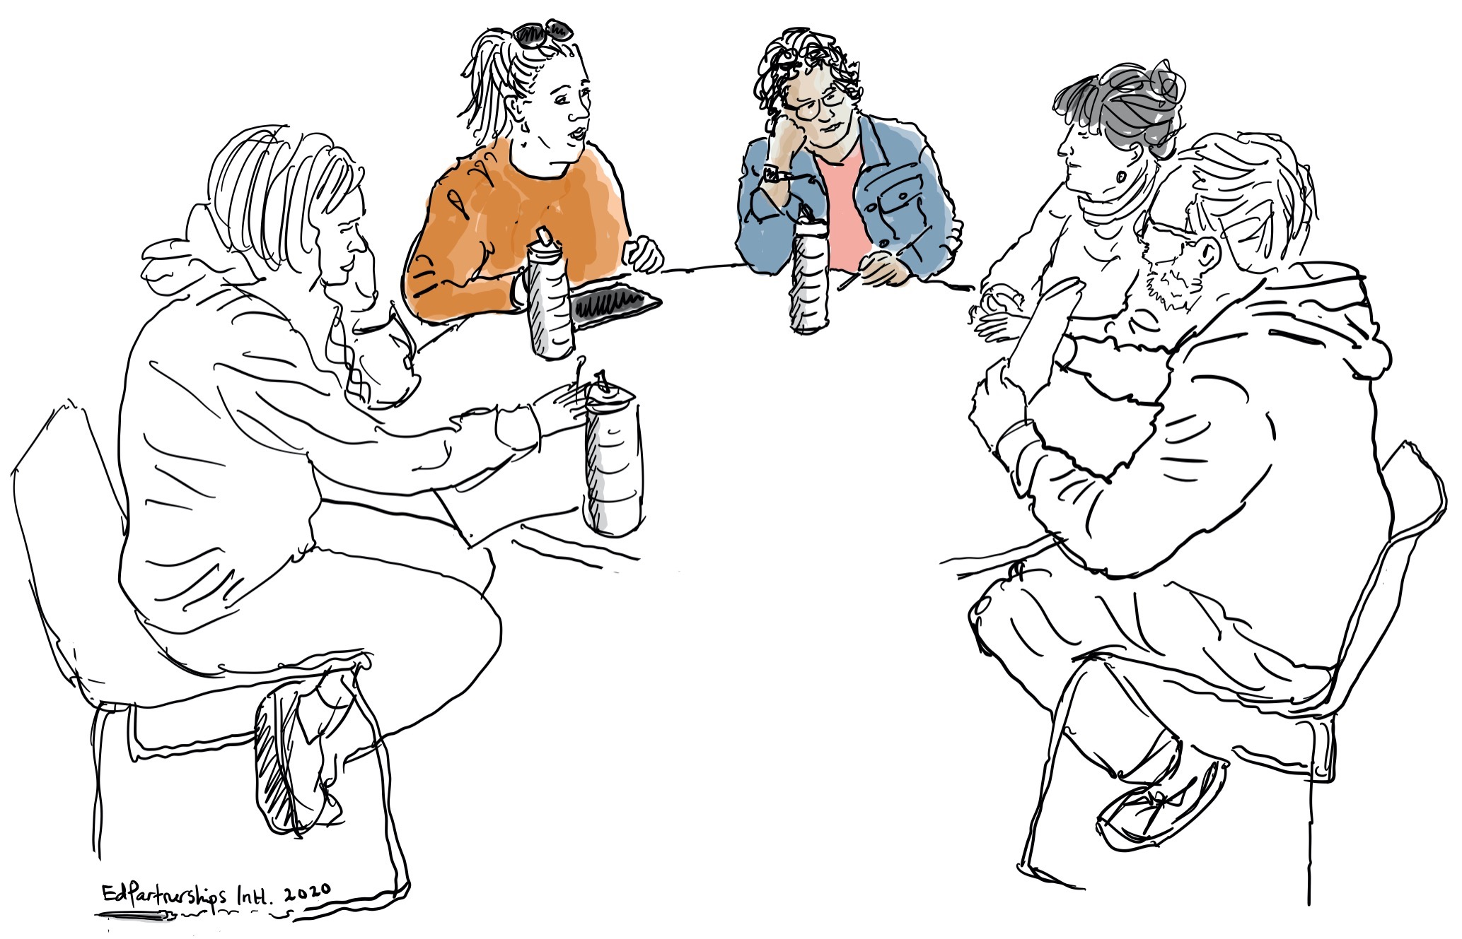
LFA 3 Strengthening Teacher Judgements against Standards
LFA 3.1 Investigation Booklet
How are we currently making teacher judgements of student learning?

Slide 2
LFA 3.1 Investigation – Contents
LFA 3.1 Investigation: How are we currently making teacher judgements of student learning?
Contents of this booklet:
An overview of LFA 3.1 Investigation …………………………………………………………………... page 2
Guides and scaffolds to support each part of the investigation
WORKSHOP 1
Guiding questions for the LFA 3.1 Investigation ……………………………………………… page 4
A note-taking scaffold for Focus Group Recorders………………………………………….. pages 5-6
WORKSHOP 2
An analysis and synthesis template to document what has been learned from each Focus Group Learning Conversation…………………………………………………………………….……. page 8

Slide 3
LFA 3.1 Investigation – Overview
LFA 3.1 Investigation - Overview
The Investigation Team (1 school leadership member and 4-5 teacher leaders) identify 6-8 teacher colleagues interested in participating in this professional learning investigation. Ensure there is a diverse mix of experiences and perspectives.
The Investigation Team then:
look through the guiding questions on page 4 and chooses/refines/creates the questions that will best reveal what the team aim to learn
split the group of 6-8 teachers in two focus groups (3 or 4 per group)
allocate two members of the Investigation Team with each focus group, one to lead the conversation, one to document.
Investigation Team members who are leading the two Focus Groups invite teachers to participate, aiming for diverse curriculum and teaching approaches and experience. Conduct the Focus Group Conversations using the guiding questions on page 4. The recorder makes notes on pages 5 and 6, capturing teacher responses as accurately as possible.
Recorders make or send copies of their notes to the investigation team.
The Investigation Lead reconvenes the Investigation Team to make sense of the evidence from the two Focus groups using the Synthesis and Analysis Scaffold to record findings on page 8.

Slide 4
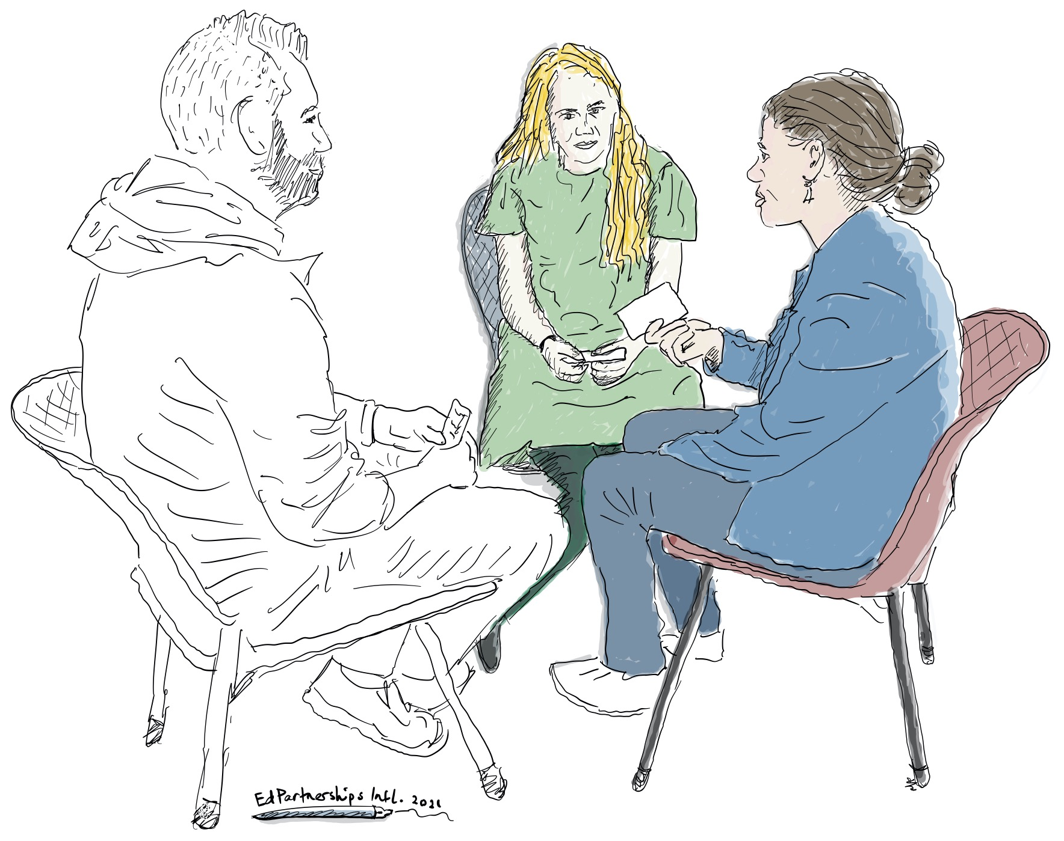
LFA 3.1 Investigation – Conduct conversations
WORKSHOP 1. Question Prompts for LFA 3.1 Investigation
The following questions are offered as a guide for the investigation team members working with the teachers focus groups – feel free to adapt the questions to better suit your local context:
When do you think you make your most accurate judgements?
What’s getting in the way of you making more accurate judgements?
What questions do you have about making more accurate judgements?
What professional learning and other support would help you get stronger at this?
When teacher judgements are more accurate, what else becomes possible?
Jot down notes during (or straight after) the conversation. Try to capture as accurately as possible in the voice of your research partners. You may wish to record this conversation on your phone or other device as a back-up or to revisit later. You will have an opportunity to share and collaboratively analyse this with colleagues as part of the research process.

Slide 5
LFA 3.1 Investigation – Record Conversations
WORKSHOP 1 (cont.). Note Taking Template for LFA 3.1 Investigation – Learning Conversation with Teachers
1. When did teachers think they made their most accurate judgements? | 2. What did teachers identify as getting in the way of making more accurate judgements?
3. What questions were on their mind in relation to making more accurate judgements? | 4. What professional learning and other support do they think they need to get stronger at this?

Slide 6
LFA 3.1 Investigation – Record Conversations
WORKSHOP 1 (cont.). Note Taking Template for LFA 3.1 Investigation – Learning Conversation with Teachers (continued)
Responses the Focus Group: When teacher judgements are more accurate, what else becomes possible?

Slide 7
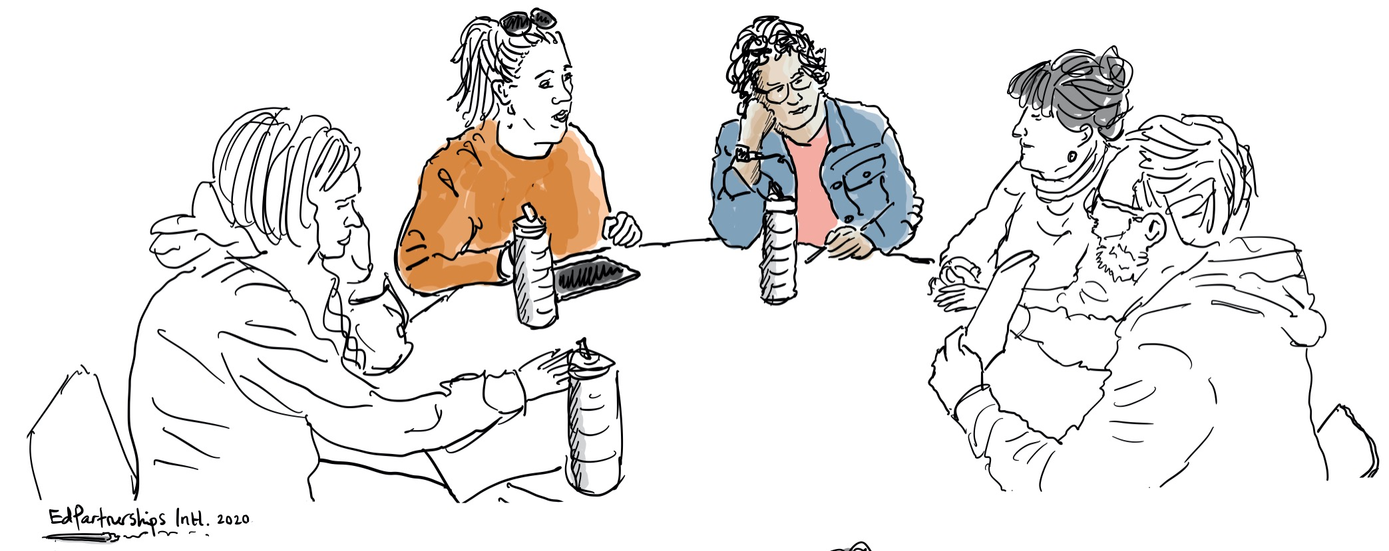
WORKSHOP 2. Analysis and Synthesis – Making Sense of our Evidence

Slide 8
LFA 3.1 Investigation – Investigation Team Synthesise and Analyse
WORKSHOP 2. LFA 3.1 Investigation - Synthesis and Analysis Scaffold for Combined Focus Group Conversations
Key ideas /themes that emerged in relation to ‘most accurate judgements?
Getting the the way of being more accurate…
What was the range of teacher capability that was uncovered?
What professional learning needs and implications emerged in relation to this?
What do teacher responses to ‘what else becomes possible reveal?
Teacher Leaders facilitate this process with the teachers who agreed to participate in one of the Focus Groups.

